Slide 1



Empowering Lives With AI and Technology
Nguyen Anh Tuan, CEO of Boston Global Forum
C20 – G20 Summit India 2023
Jaipur, India, July 29-31, 2023

Slide 2
Boston Global Forum
Background
Founded in 2012
The Boston Global Forum (BGF) offers a venue for leaders, strategists, thinkers, and innovators to contribute to the process of Remaking the World – Toward an Age of Global Enlightenment.
Definition:
  The Enlightenment – ​​the great 'Age of Reason' – is defined as the period of rigorous scientific, political and philosophical discourse that characterized European society during the 'long' 18th century: from the late 17th century to the ending of the Napoleonic Wars in 1815.
  Global Enlightenment: largely defined by the potential of Artificial Intelligence (AI), blockchain, and other Digital Age technologies.

Slide 3

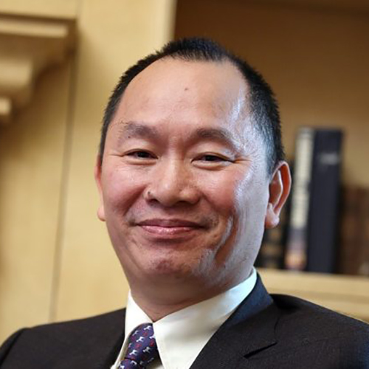

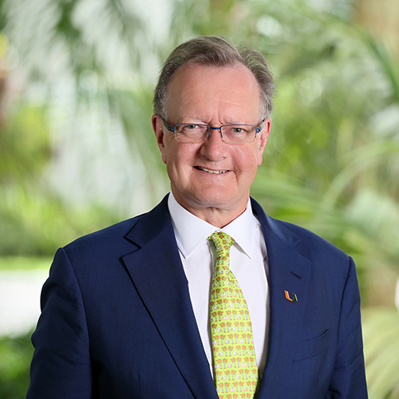
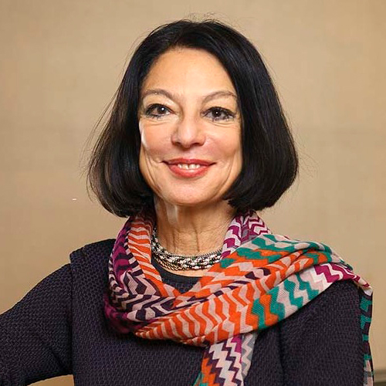


BGF Founders and Board Members
Governor Michael Dukakis, Co-Founder and Chairman
Nguyen Anh Tuan, Co-Founder and CEO
Thomas E. Patterson, Co-Founder and Board Member
John Quelch, Co-Founder and Board Member
Nazli Choucri, Board Member
Alex ‘Sandy’ Pentland, Board Member
David Silbersweig, Board Member
Notes:
Governor Michael Dukakis,
3 Harvard Professors: Tom, John, David S
MIT Professors:

Slide 4
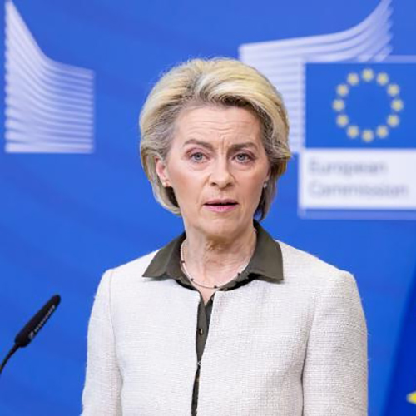

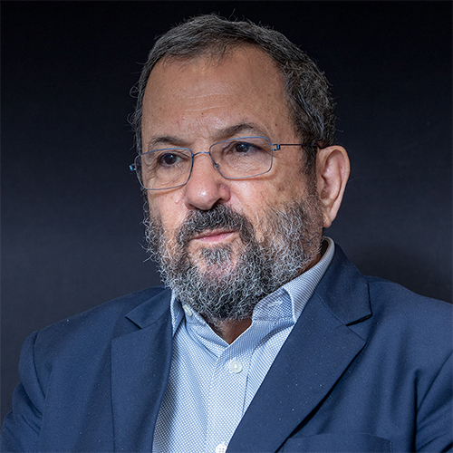

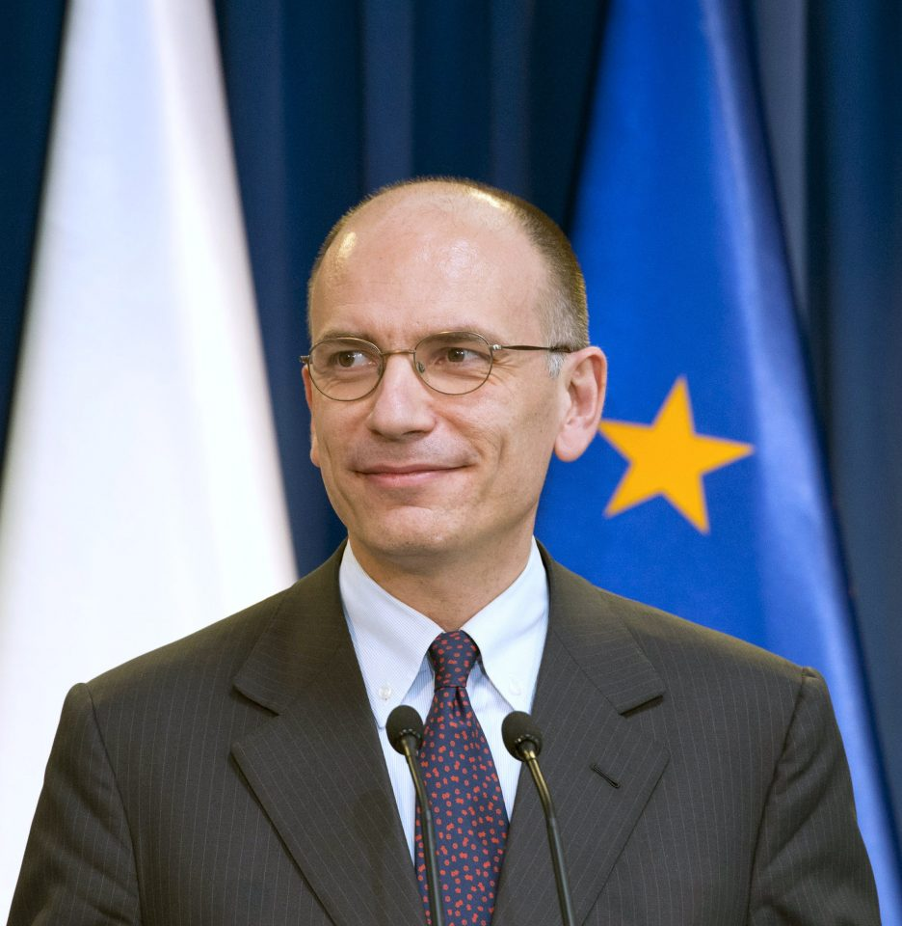
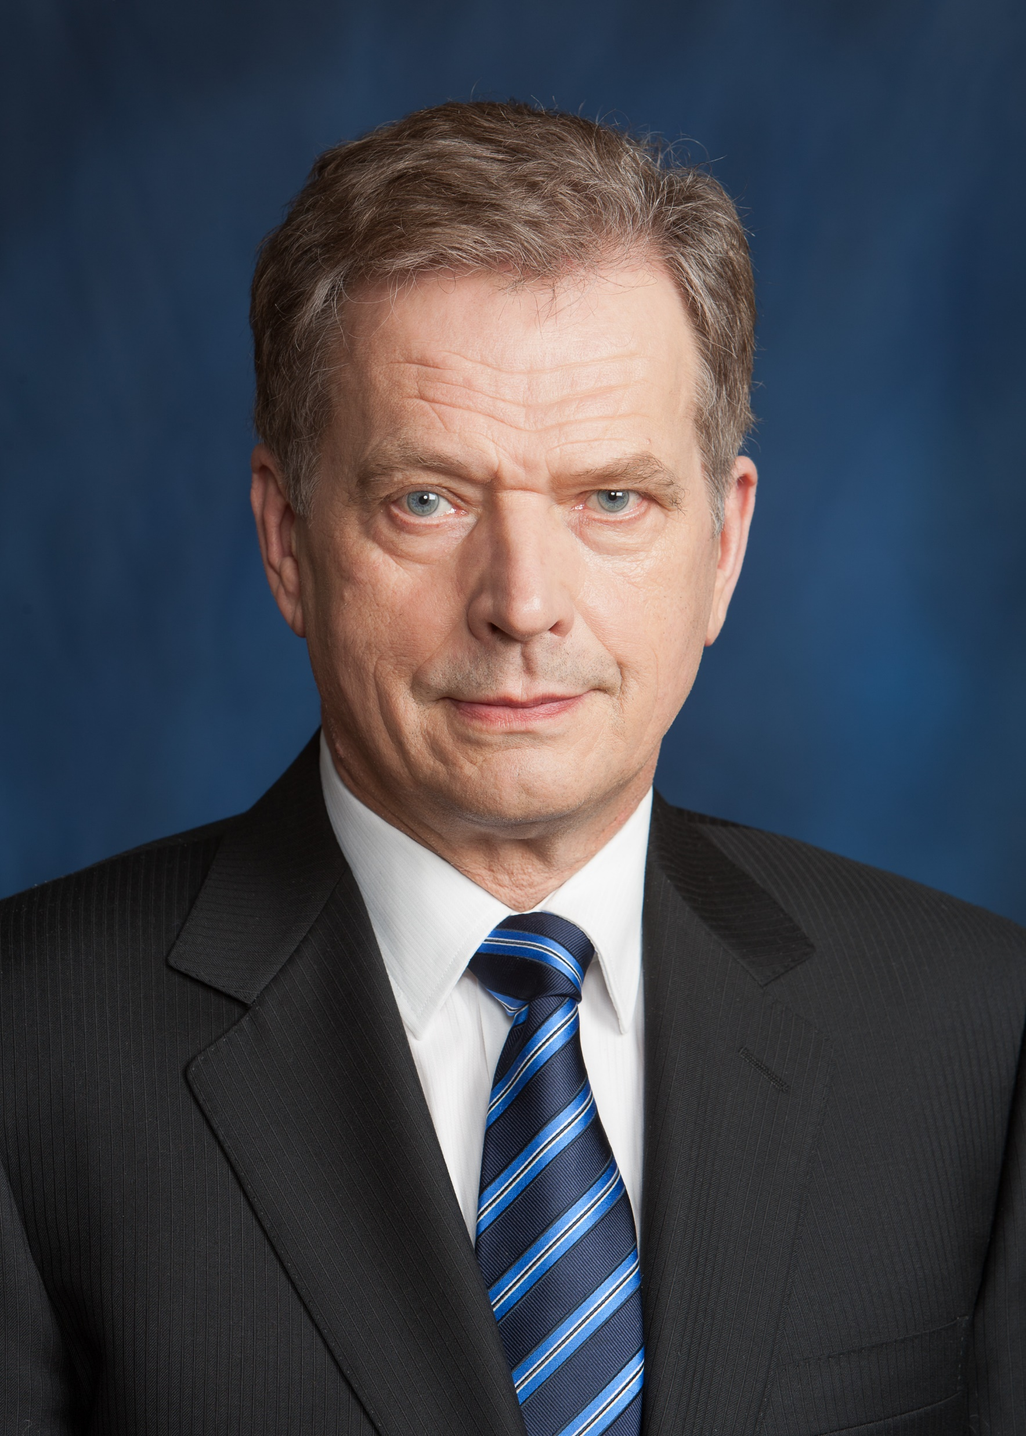

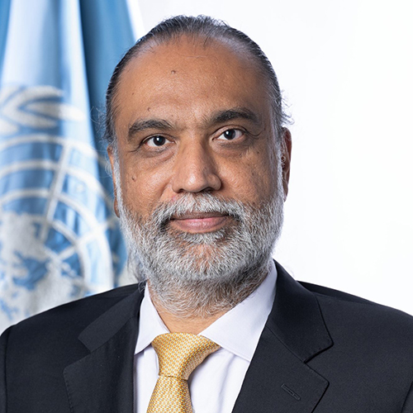
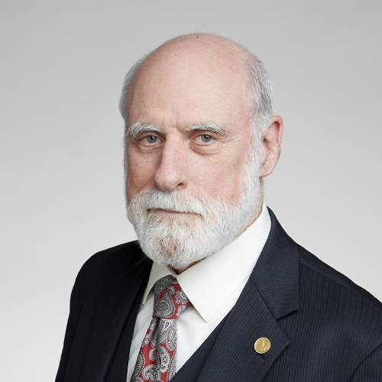



Global Enlightenment Leaders
Ursula von der Leyen, President of the European Commission
Shinzo Abe, Former Prime Minister of Japan
Ban Ki-Moon, Former Secretary-General of the United Nations
Ehud Barak, Former Prime Minister of Italy
Sauli Niinistö, President of Finland
Ursula von der Leyen, President of the European Commission
Ehud Barak, Former Prime Minister of Israel
Andreas Norlén, Speaker of the Swedish Parliament
Amandeep Gill, Under Secretary General and UN’s Envoy on Technology
Vint Cerf, “Father of the Internet”
Vaira Vīķe-Freiberga, 6th President of Latvia
Sanae Takaichi, Minister of State for Economic Security of Japan
Joseph Nye, Harvard University Distinguished Service Professor

Slide 5
Boston Global Forum Initiatives
Boston Global Forum Initiatives
AI World Society (AIWS): UN100 - AIWS City, Social Contract for the AI Age
BGF-G7 Summit, AIWS-G7 Summit, Shinzo Abe Initiative for Peace and Security
C20 Initiative: From Enlightenment to Global Enlightenment – “You are the Light”
GLIDES – C20 Summit Initiative
BGF World Leaders for Peace and Security Award
BGF World Leaders in AIWS Award
Notes:
Explain what is AIWS City – AI World Society
Benefit and why it is important
BGF World Leaders: Shinto Abe, Angela Merkle,

Slide 6


Slide 7

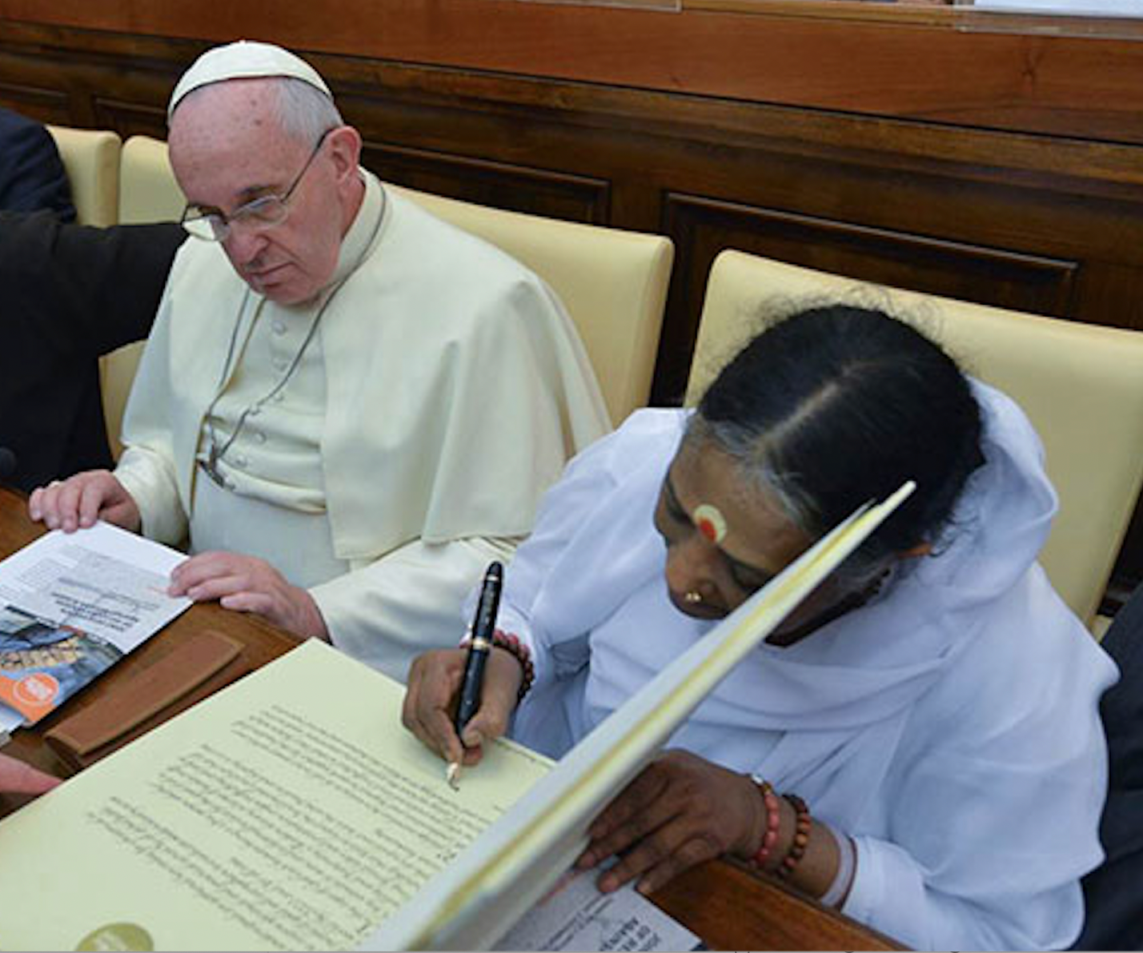
AIWS – UN100 - the Age of Global Enlightenment
The Social Contract for the AI Age
AI International Accord – Global Legal Framework for AI and Digital
Age of Global Enlightenment
Standards, Values: the book “Remaking the world – Toward an Age of Global Enlightenment” and Amma’s spiritual values
Notes:
Global Enlightenment Politics
Global Enlightenment Technology
Global Enlightenment Economy
Global Enlightenment Education
Global Enlightenment Science
Global Enlightenment Mental Health
Global Enlightenment Conflict Resolution

Slide 8

AIWS City, a practical model of AIWS
Community and Network:
- World Leaders for Peace and Security
- World Leaders in AIWS
- Global Enlightenment Community
Recognizing:
- Global Enlightenment Cities: Boston, San Francisco, Tokyo, Rome, Stockholm, New Delhi, London, Rio de Janeiro, Abuja
- Global Enlightenment Universities
- Landmarks & Legends
- Products and Services
- Music, Art, Movies, Films, Literature, Sports

Slide 9
Collaboration BGF and GLIDES at C20 Summit: AIWS City and Amma’s spiritual values
Global Enlightenment Community
Connect Global Enlightenment Universities: Harvard, MIT, Stanford, Berkeley, University of Tokyo, Amrita University, University for Peace, Oxford, Cambridge, Florence, and subsequently, extend support to Federal University of Rio de Janeiro, University of Lagos, and other institutions.
Build Tech Economy Alliance for the Age of Global Enlightenment: USA, EU-UK, Japan, India, Brazil, Mexico, Indonesia, Nigeria, Vietnam, Philippine.
The AIWS City stands as the central pillar of BGF and GLIDES' initiative, embodying a practical model for the Age of Global Enlightenment. It seamlessly integrates advanced technology based on AIWS Standards with the profound application of Amma's spiritual values.

Slide 10

Contribute to citizens, CSOs:
“Citizens are empowered through the AIWS model, data economy and global enlightenment education, uniting their voices as power of users, market forces, and innovators.”
AIWS City as a platform for:
Education:
Economy and Society: The AIWS
Innovation aims to apply data economy principles, empowering every citizen to
become an innovator
Politics: empower citizens to actively engage in politics and contribute to society, amplifying their voices to reach governments and companies.
AIWS Rewards:
Shaping Culture: Global Enlightenment Cultures and Spirits infused with Amma's values, fostering a world characterized by compassion and selflessness.

Slide 11
Implementation for the Global South:
India - a hub and center for the Global South, the integration of Amrita University and Amma's spiritual values. Collaboration with Brazil for C20 2024 and Nigeria is a priority, forming a strong foundation for expanding our reach to other countries in the Global South.
Connect key universities in India, Brazil, Nigeria, Indonesia, and Vietnam.
Global Enlightenment Community support and contribute to India, Brazil, Indonesia, and Nigeria, empowering their citizens and civil society organizations with AIWS City initiatives.

Slide 12
Key takeaways
Joint report - GLIDES & Boston Global Forum
Alliance: Between BGF & GLIDES for 3rd party oversight for AI Systems
Training for CSOs and make global citizens be part of the process and drive the strategy
Enable CSOs to have a larger voice to drive innovation with governments, privates and academia for AI

Slide 13

Thank you and see you in C20 Brazil 2024.

