Slide 1
Strategies for Democracy to Win in the AI Battle
Yi-Jing Lin
Deputy Minister of Digital Affairs, Taiwan
2024/11/25

Slide 2
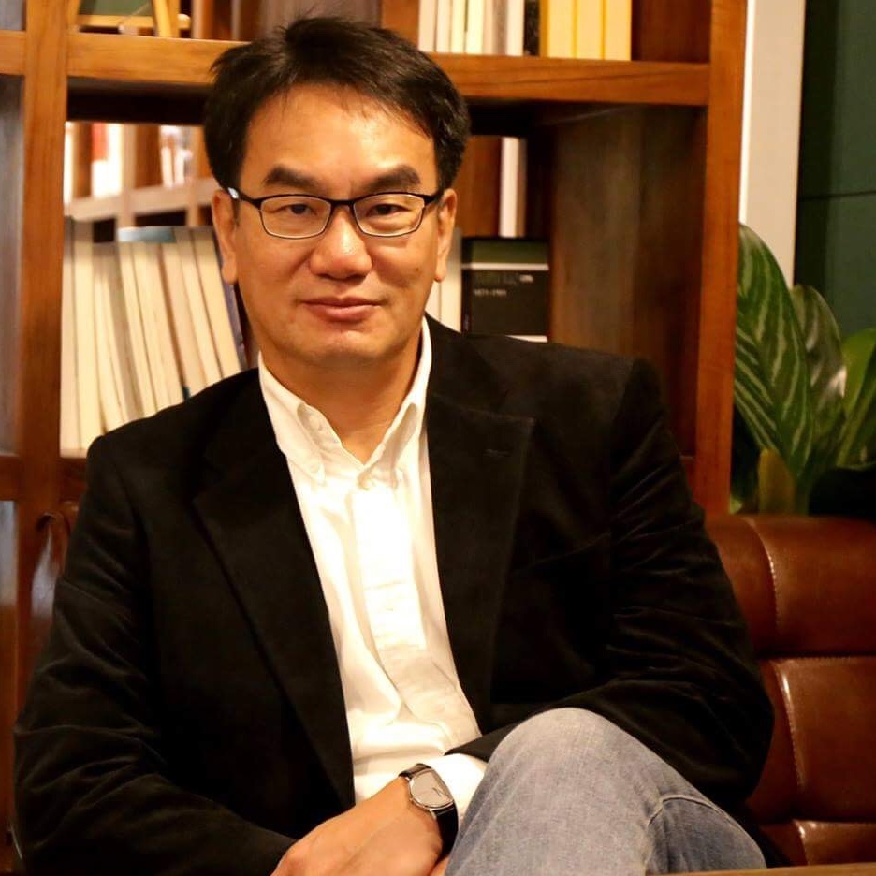
Dr. Yi-Jing Lin
1983-1987 B.E. in Computer Science, National Taiwan University
1989-1995 PhD in Computer Science, Brown University, USA
1995-1996 IBM TJ Watson Research Center, USA
1996-1997 Manager of Compeq Manufacturing, Taiwan
1999-2001 Director of Trend Micro Taiwan & Japan
2001-2024 Founder and CEO of L Labs Inc. (MyET-MyCT-MyJT)
2024- Deputy Minister of Digital Affairs, Taiwan

Slide 3
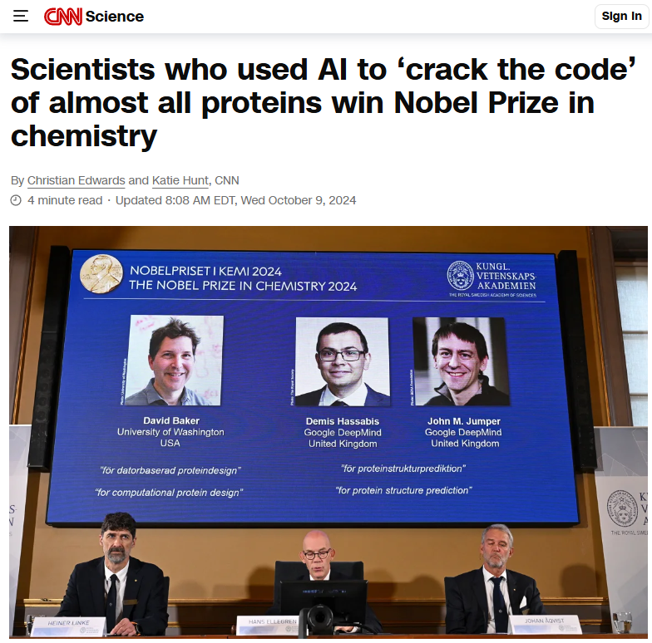
1. AI won Nobel Prizes

Slide 4
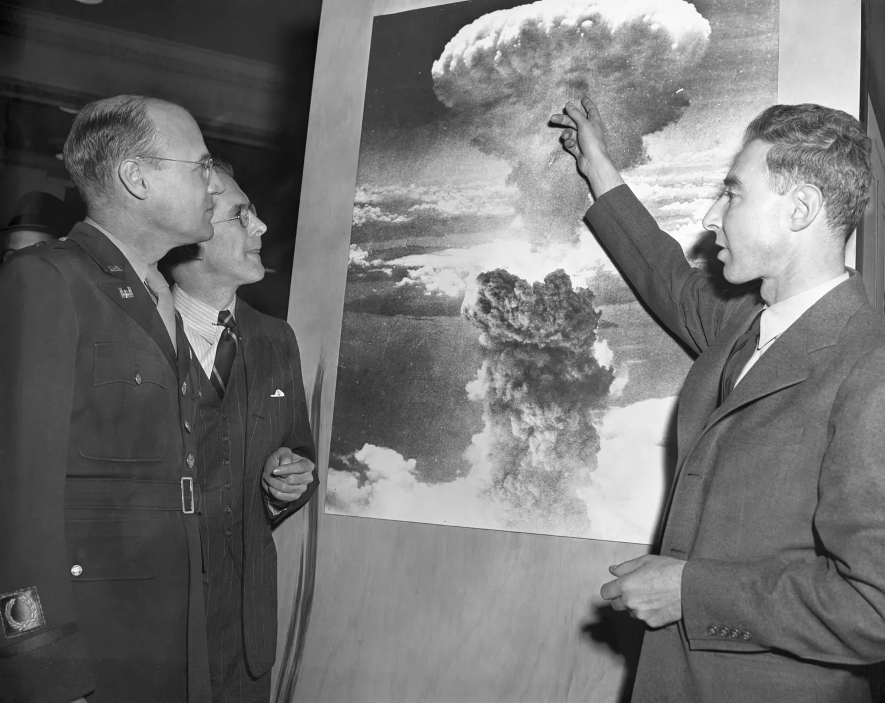
2. AI is a huge threat to humanity
When you see something that is technically sweet, you go ahead and do it.
Geoffrey Hinton
BBC News
J. Robert Oppenheimer
Bettmann Archive / Getty Images

Slide 5
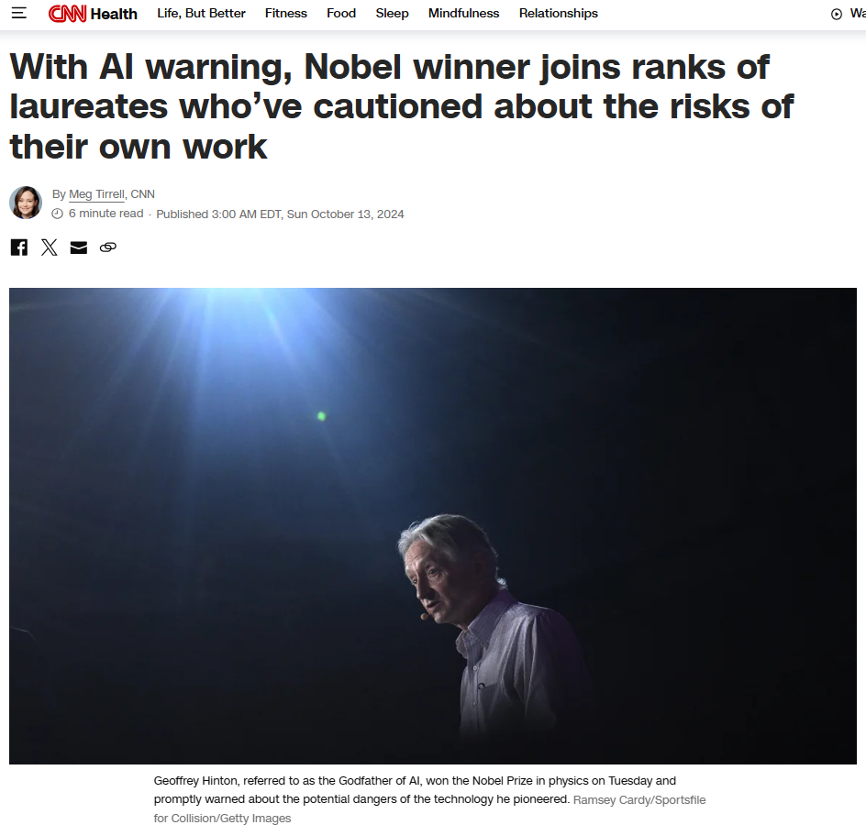
3. Nobody can stop the development of AI
Geoffrey Hinton
Sam Altman
Geoffrey Hinton

Slide 6
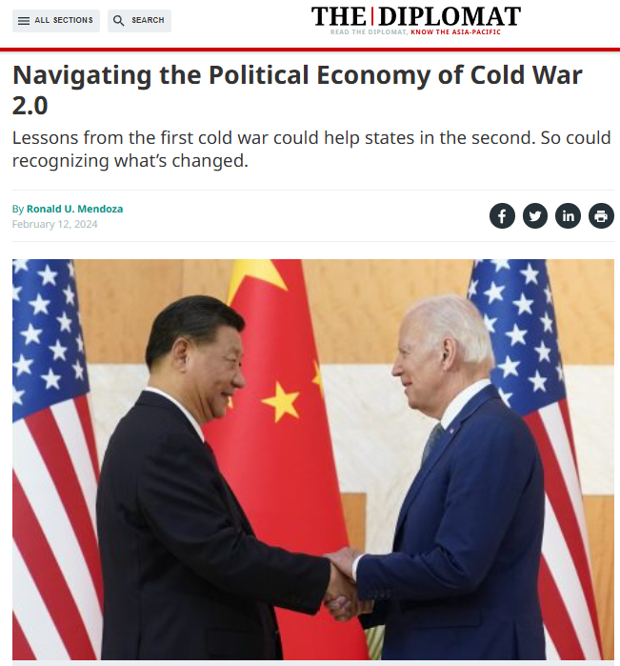
4.The one who controls AI will control the future

Slide 7
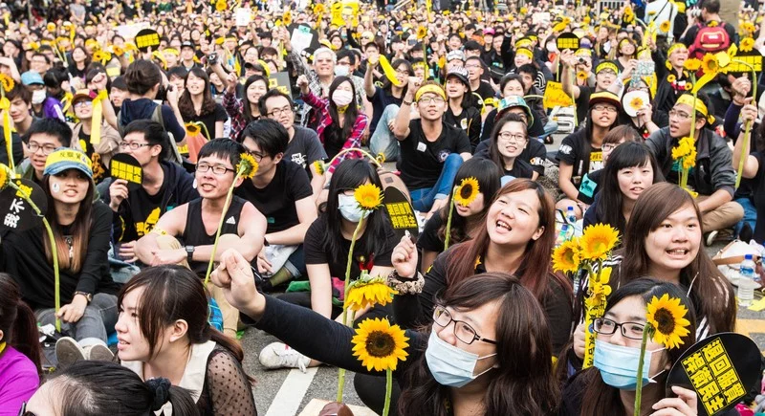
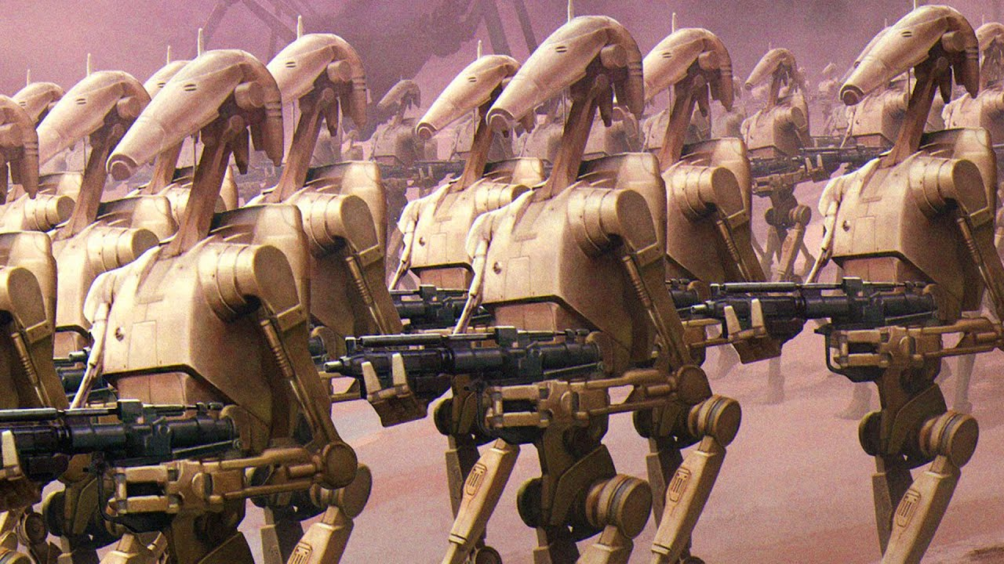
5. AI believes in what it is trained with
Star Wars: The Phantom Menace (1999)
Chinese Students, 1960s
Taiwanese Students, 2014
AI Students, 2040?

Slide 8
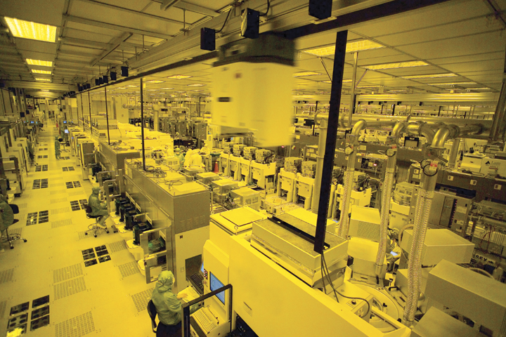
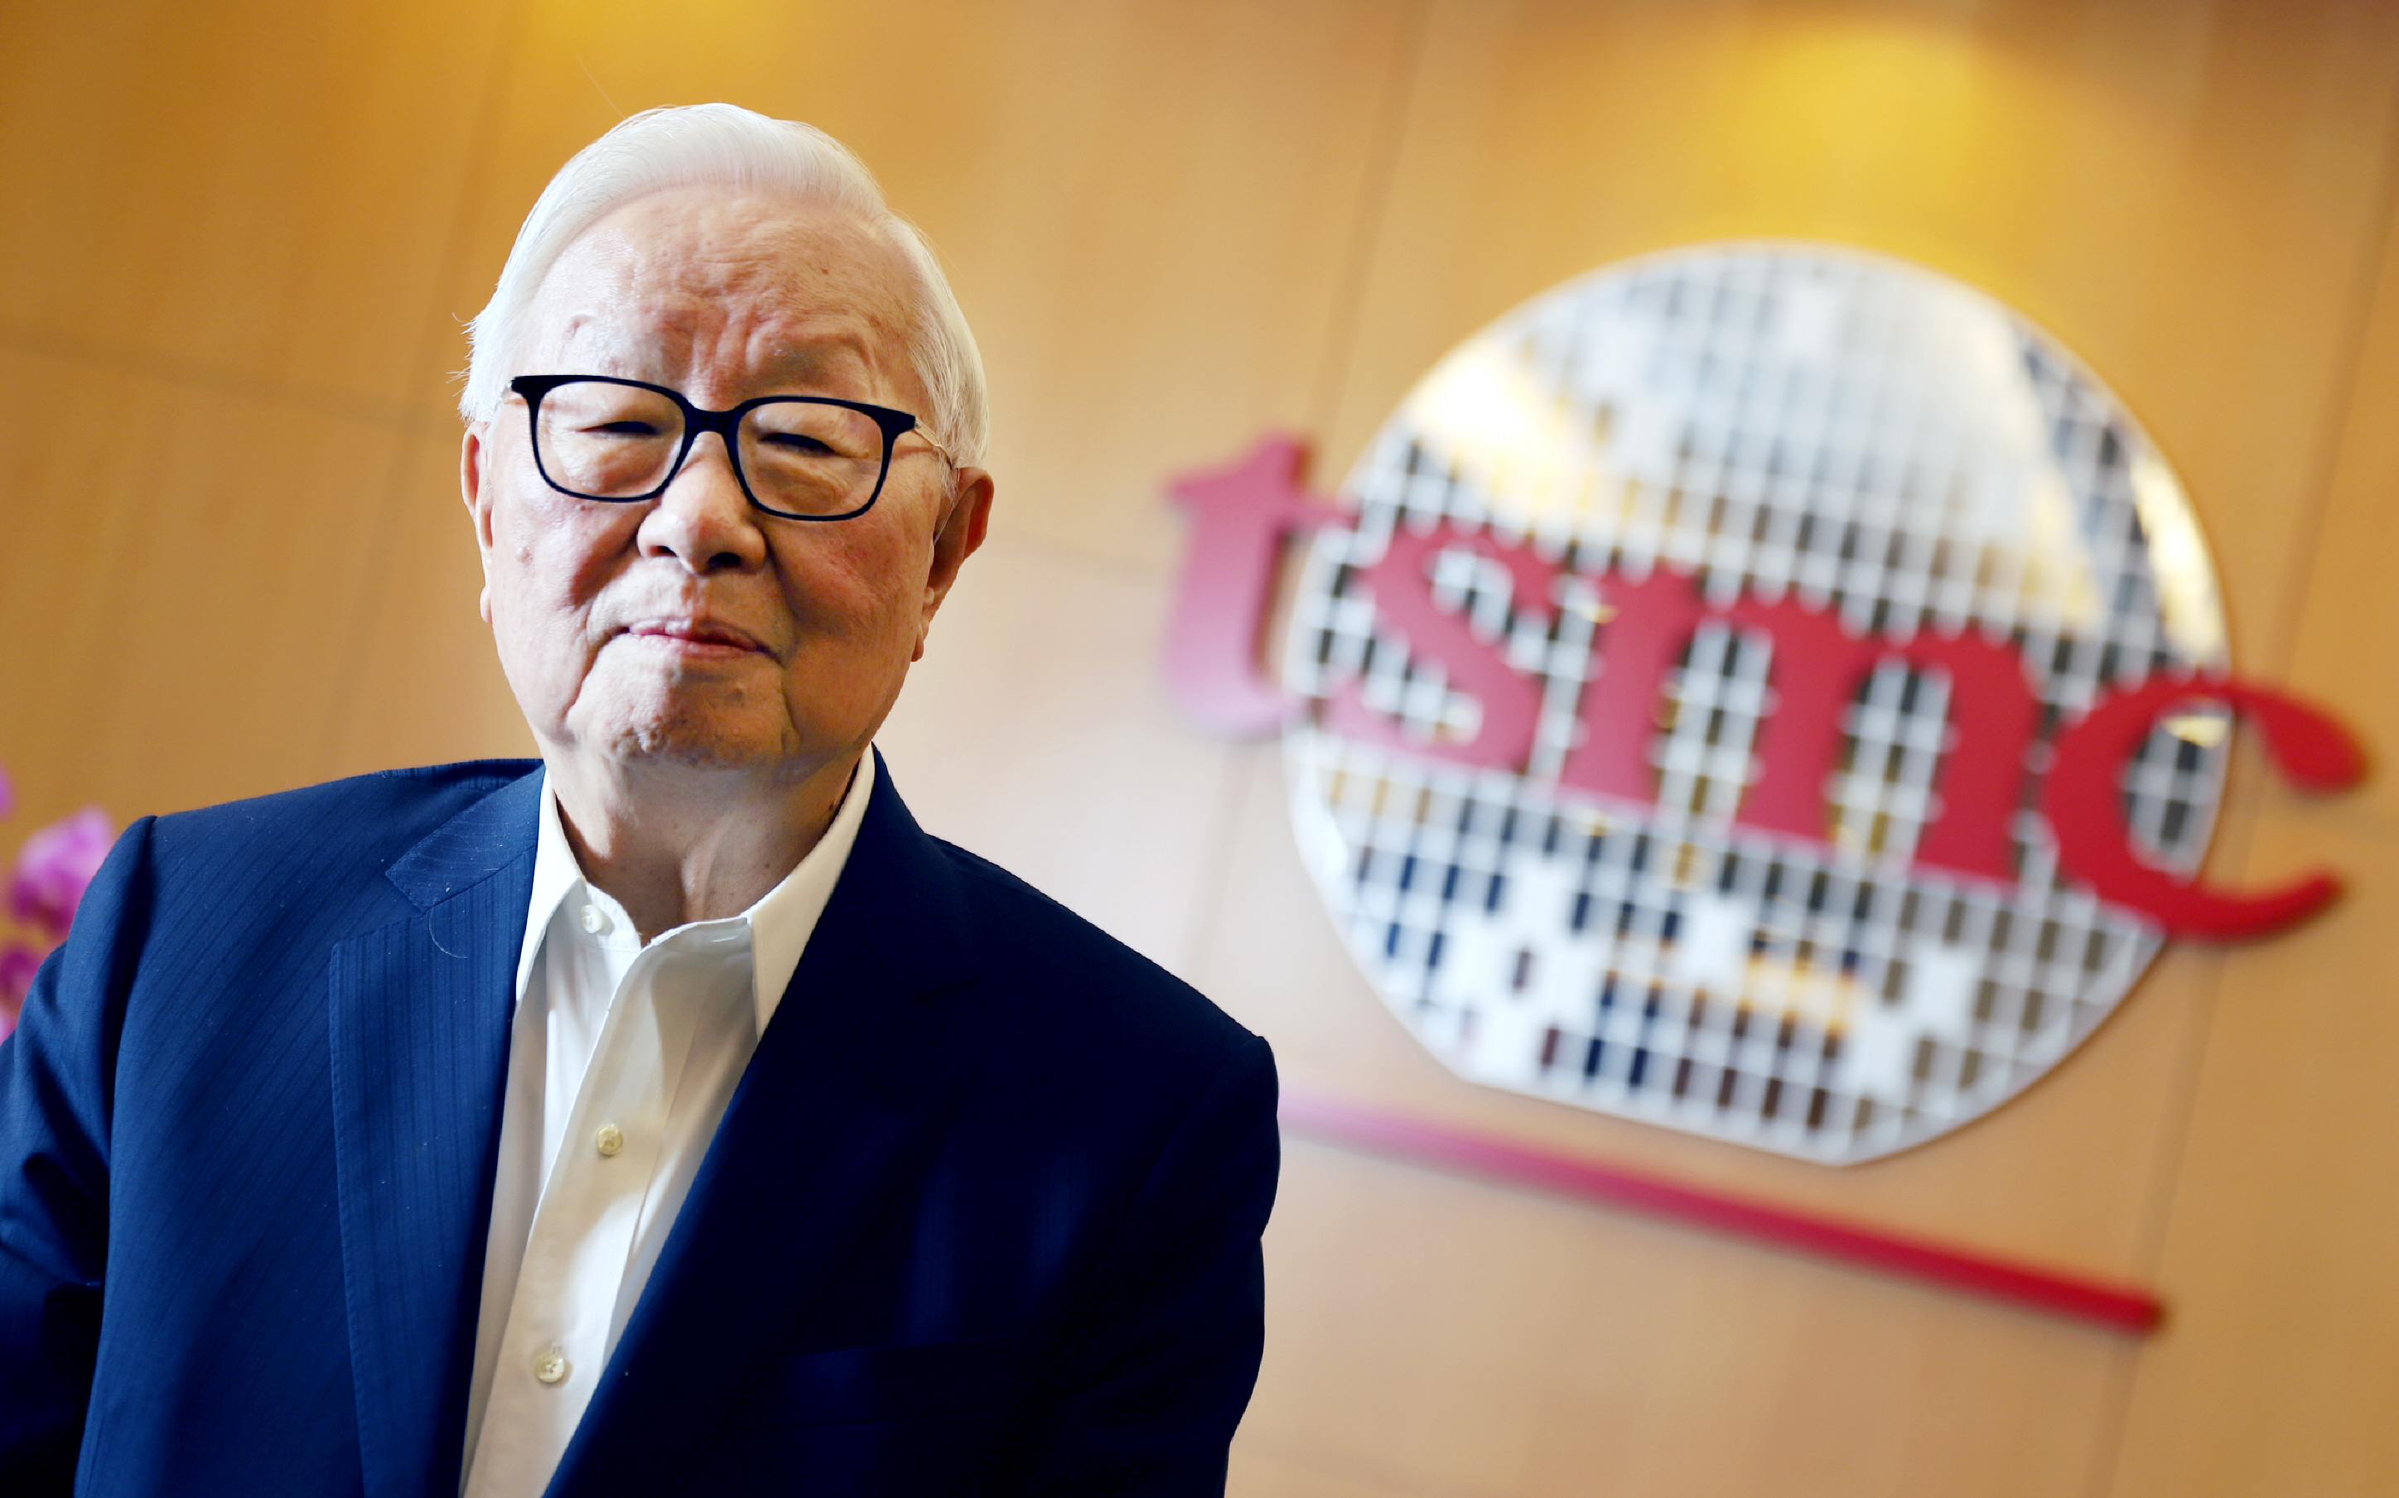
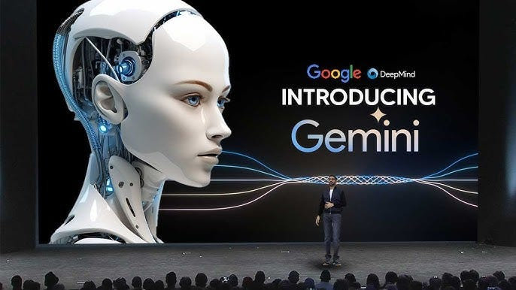
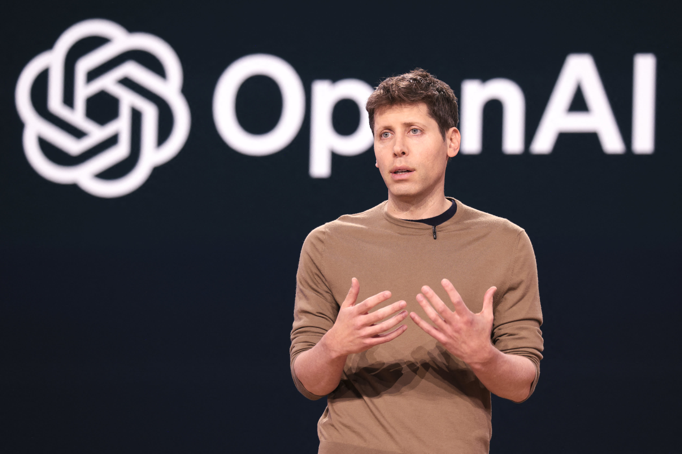
6. USA + Taiwan = Democratic AI?
IC Made in Taiwan
Software Made in USA

Slide 9
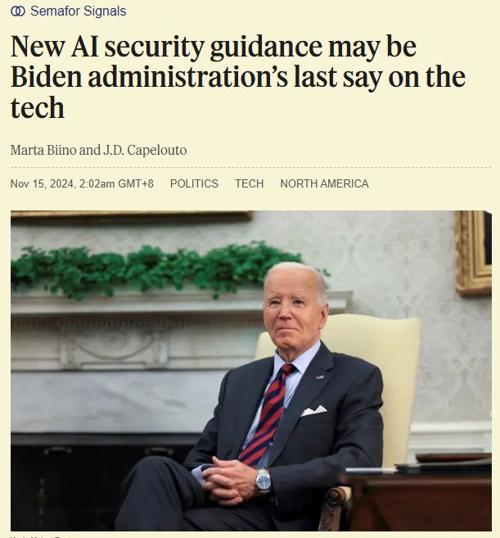
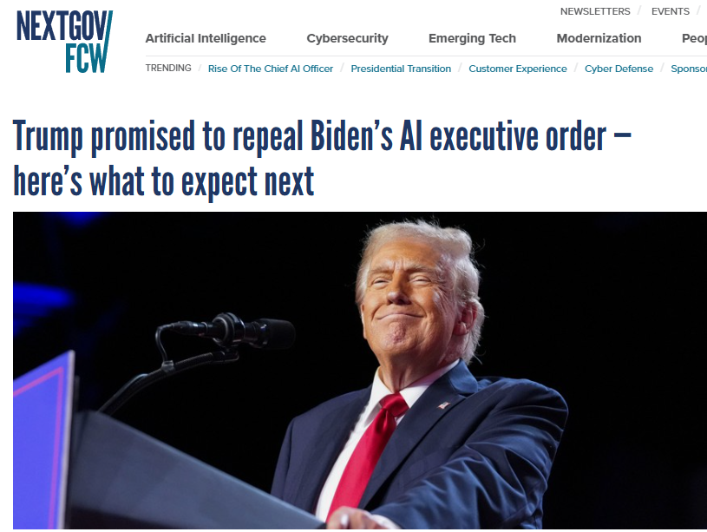
7. Regulation Hinders Innovation?
European Union, 2024
USA, 2014
USA, 2025?
Will we become another evil when fighting evils?
Will AI take over humanity?
Will AI exacerbate inequality ?

Slide 10
Conclusion
AI won Nobel Prizes.
AI is a huge threat to humanity.
Nobody can stop the development of AI.
The one who controls AI will control the future.
AI believes in what it is trained with.
USA + Taiwan = Democratic AI?
Regulation Hinders Innovation?

