Slide 1

Acceptance Remarks
Cynthia Dwork, Harvard University

Slide 2
Statistics “Feel” Private
A quantity computed from a sample, tells us about the population as a whole
Two datasets, collected independently from same population and with correct methodology, should tell us essentially the same things
Sense of privacy derived from this fact
  “No one knows I am in the sample … I can claim I opted out”
  “It’s not about *me*”
Notes:
A statistic is a quantity computed from a sample. It is supposed to tell us something about the population as a whole. Two datasets, both collected with proper sampling methodology, should tell us the same thing – this is why the discipline of statistics works! Our sense of privacy is derived from this fact. One might think, “No one knows I was in the sample,” or, “The results would look the same even if I had opted out”. “It’s not about me.” Statistics would fail as a discipline if any single person’s presence or absence completely changed the results.

Slide 3
Statistics “Feel” Private
A quantity computed from a sample, tells us about the population as a whole
Two datasets, collected independently from same population and with correct methodology, should tell us essentially the same things
Sense of privacy derived from this fact
  “No one knows I am in the sample … I can claim I opted out”
  “It’s not about *me*”
Overly accurate estimates of too many statistics
is blatantly non-private
Dinur and Nissim 2003
Notes:
Nonetheless, the law of information reconstruction tells us that overly accurate estimates of too many statistics is blatantly non-private. This mathematical limit is tied to the accuracy, just as the number of medical images that can safely be taken depends on the radiation dosage delivered by the images in question. You can have more dental x-rays than you can have mammograms.

Slide 4
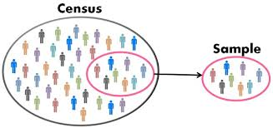
“Statistical” Privacy for All Computations
Differential privacy preserves “I could have opted out” privacy for every computation, including total population counts
Image credit: Keydifferences.com

Slide 5

Privacy-Preserving Data Analysis?
q₁
a₁
M
q₂
a₂
q₃
a₃
Database
data analyst
Notes:
Helen Nissenbaum

Slide 6
Privacy-Preserving Data Analysis?
“Can’t learn anything new about Nissenbaum”?
Dalenius, 1977
q₁
a₁
M
q₂
a₂
q₃
a₃
Database
data analyst
Notes:
A natural candidate, certainly the one that I first tried, was articulated by Tore Dalenius in 1977. It says that the data analyst can’t learn anything “new” about Nissenbaum. NIssenbaum may be an extrovert and publish all sorts of things about herself on the web, that’s fine, and we don’t punish the statistical database for revealing this, but the analyst shouldn’t be able to glean any new particulars about NIssenbaum.

Slide 7
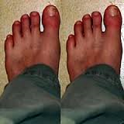
Privacy-Preserving Data Analysis?
“Can’t learn anything new about N”?
Then what is the point?
q₁
a₁
M
q₂
a₂
q₃
a₃
Database
data analyst

Slide 8

Privacy-Preserving Data Analysis?
“Can’t learn anything new about N”?
Then what is the point?
q₁
a₁
M
q₂
a₂
q₃
a₃
Database
data analyst
Notes:
Has Nissenbaum’s privacy been compromised?

Slide 9
Privacy-Preserving Data Analysis?
Ideally: learn same things if Nissenbaum opts out
q₁
a₁
M
q₂
a₂
q₃
a₃
Database
data analyst

Slide 10
Differential Privacy
The outcome of any analysis is essentially equally likely, independent of whether any individual joins, or refrains from joining, the dataset.
  What is the source of uncertainty in “likely”?
Algorithm will flip coins
Dwork, McSherry, Nissim, Smith 2006
Notes:
This leads us to the English language definition of Differential Privacy.

Slide 11
Differential Privacy
The outcome of any analysis is essentially equally likely, independent of whether any individual joins, or refrains from joining, the dataset.
  What is the source of uncertainty in “likely”?
Algorithm will flip coins
$$\operatorname{Pr}\left[M\left(x\right)∈S\right]≤e^{ε}\operatorname{Pr}\left[M\left(y\right)∈S\right]$$
Dwork, McSherry, Nissim, Smith 2006
Notes:
This leads us to the English language definition of Differential Privacy.

Slide 12
Differential Privacy
The outcome of any analysis is essentially equally likely, independent of whether any individual joins, or refrains from joining, the dataset.
  What is the source of uncertainty in “likely”?
Algorithm will flip coins
$$\operatorname{Pr}\left[M\left(x\right)∈S\right]≤(1+ε)\operatorname{Pr}\left[M\left(y\right)∈S\right]$$
Dwork, McSherry, Nissim, Smith 2006
Notes:
This leads us to the English language definition of Differential Privacy.

Slide 13
Differential Privacy
Anything learned about you can be learned even if you opt out of the dataset.
$$\operatorname{Pr}\left[M\left(x\right)∈S\right]≤e^{ε}\operatorname{Pr}\left[M\left(y\right)∈S\right]$$
Dwork, McSherry, Nissim, Smith 2006
Notes:
Reformulating: anything that can be learned about you can be learned even if you opt out
This kind of privacy for training data not only protects people, it protects intellectual property: a differentially private language model will not infringe on copyright. This is not science fiction, it is available now, in VaultGemma.

Slide 14
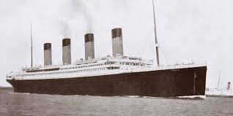
Our Decisions
Notes:
Our decisions. Scale responsibly or irresponsibly; have lifeboats sufficient for all on board, or not. This is the stuff of regulation. Government must protect the populace; the decisions must be made democratically.

Slide 15


Teachings vs Participation
q₁
a₁
M
q₂
a₂
q₃
a₃
Database
data analyst
Notes:
Knowledge can cause harm; DP separates the harms from the teachings from the harms due to participation
Suppose the database teaches us that smoking causes cancer….. Smoker S is harmed: her insurance premiums might rise.
[[click]]Smoker S’s premiums would rise even if she were not in the database.
And smoking causes cancer is the kind of fundamental truths things we want to learn from medical data.
DP supports science!

Slide 16
Key Properties of Differential Privacy
Future-Proof
  Resilient to present – or future – information from other sources
Composes Gracefully and Automatically
  Understand accumulated privacy loss over multiple adaptively chosen computations; at worst the epsilons add up
Differential privacy is programmable
q₁
a₁
M
q₂
a₂
q₃
a₃
Database
data analyst
Notes:
Just we we could never learn which coin – the fair one or the slightly biased one – was flipped, an adversary can never learn which of 2 adjacent dbs was the real one based on future info from other sources

Slide 17
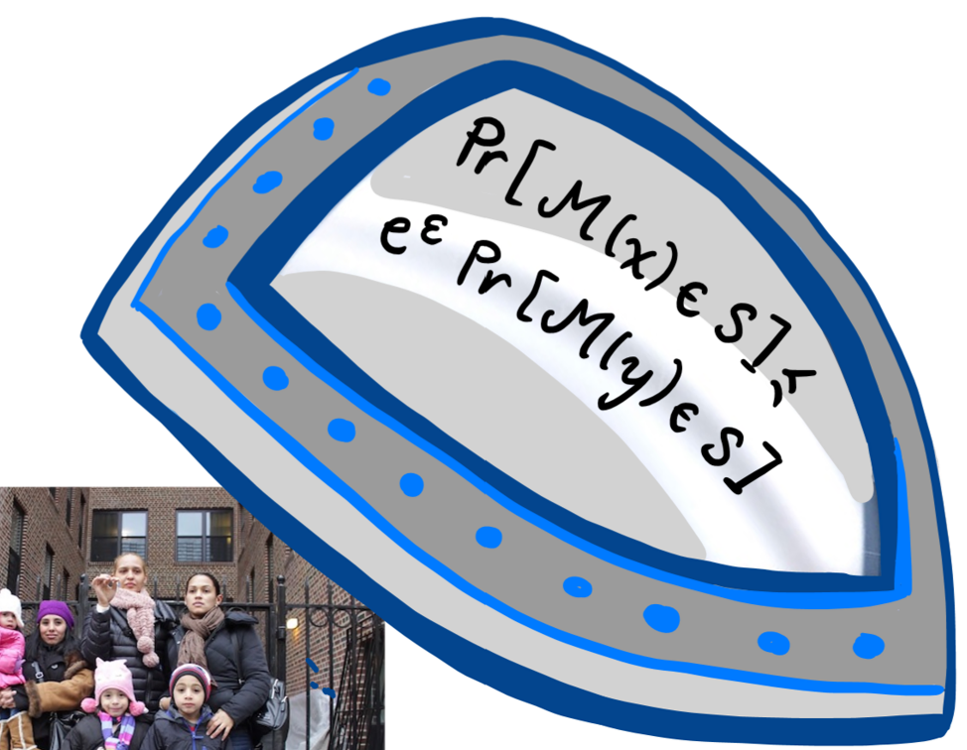
Thank you
Boston Global Forum
May 1, 2026

